Slide 1
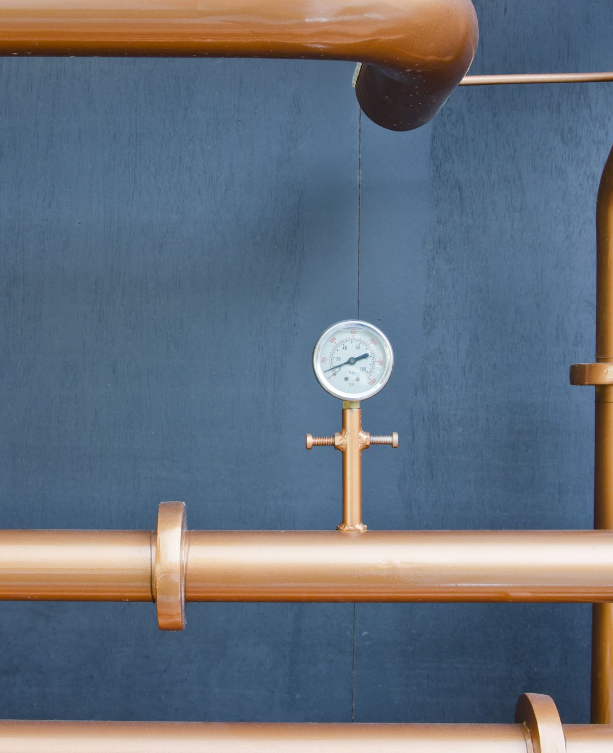
Graduation project Electric Water Heater
Presented by:
Omar Walid Abdelkader
Youssof Walid Mohamed

Slide 2
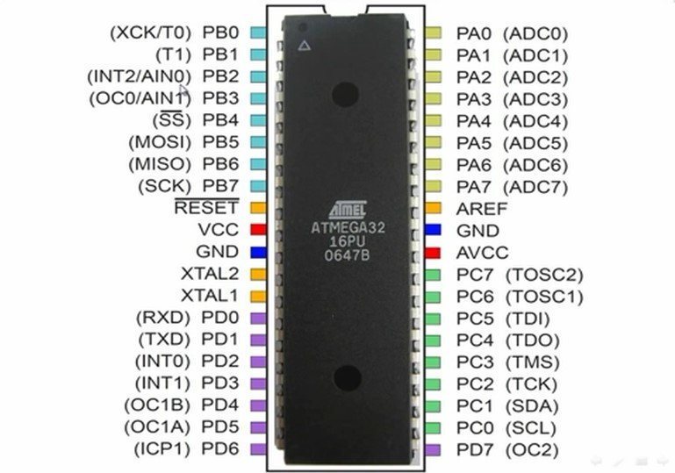
Components.
1. 24C08 EEPROM, or use the internal.
2. Temp sensor (LM35, or equivalent DS18B20).
3. Cooling Element (Peltier).
4. Heating Element (3d ceramic heater).
5. 7-segments.
6. LEDs.
7. Push Buttons.
8. Solid State Relays.
9. Cooling fins & fans.

Slide 3
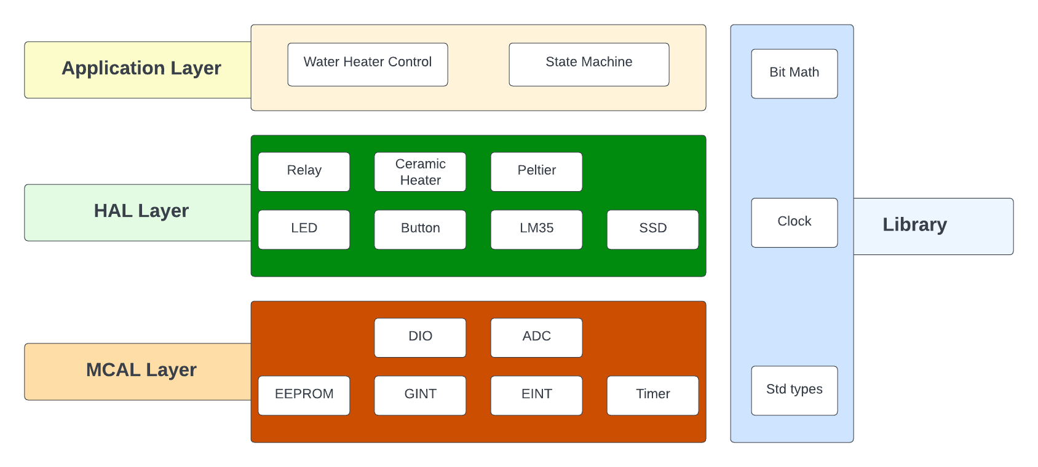
Layered Architecture

Slide 4
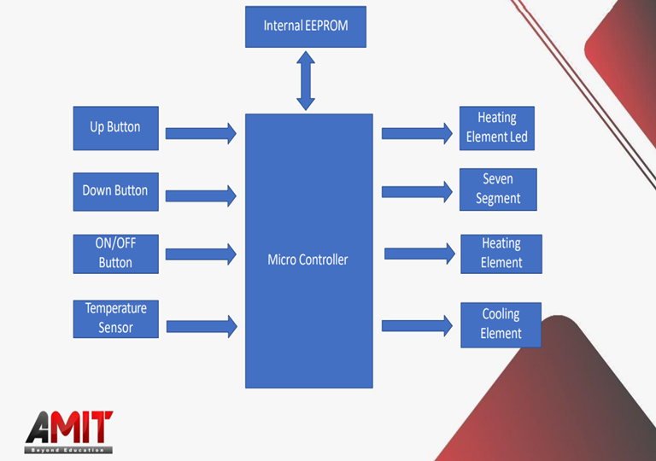
Diagram Layout

Slide 5

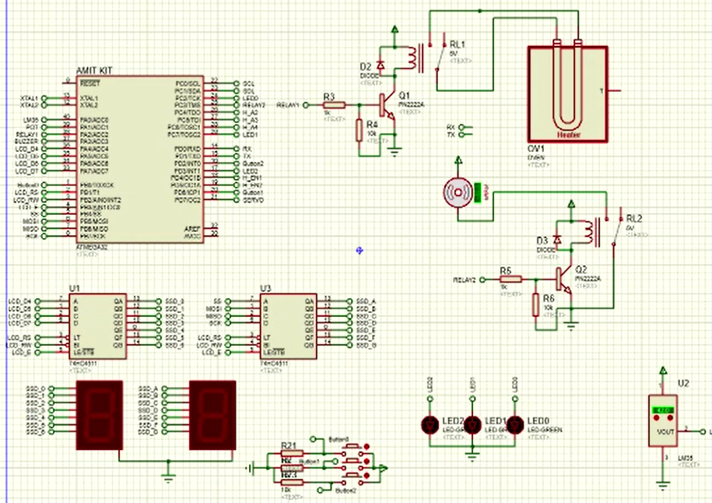
Schematic Layout

Slide 6
Specifications –Temperature Setting
The “Up” or “Down” buttons are used to change the required water temperature (set temperature).
After entering temperature setting mode, a single “Up” button press increase the set temperature by 5 degrees.
After entering temperature setting mode, a single “Down” button press decrease the set temperature by 5 degrees.
The minimum possible set temperature is 35 degrees.
The maximum possible set temperature is 75 degrees.
If the electric water heater is turned OFF then ON, the stored set temperature should be retrieved from the “External E2PROM”.
The initial set temperature is 60 degrees.

Slide 7
Specifications –Temperature Sensing
The temperature sensor measures the water temperature.
The water temperature should increase, if the “Heating Element” is ON.
The water temperature should decrease, if the “Cooling Element” is ON.
Temperature should be sensed once every 100 ms.
The decision to turn ON or OFF either the “Heating Element” or the “Cooling Element” based on the average of the last 10 temperature readings
The “Heating Element” should be turned ON, if the current water temperature is less than the set temperature by 5 degrees.
The “Cooling Element” should be turned ON, if the current water temperature is greater than the set temperature by 5 degrees.

Slide 8
Specifications –Seven Segments
Seven segment by default show the current water temperature or the set temperature.
If the electric water heater is in the temperature setting mode, the 2 seven segment displays should blink every 1 second and show the set temperature.
In the temperature setting mode, every change in the set temperature should be reflected on the 2 seven segment displays.
The 2 seven segment display should exit the temperature setting mode, if the“UP” and “Down” buttons are not pressed for 5 seconds.

Slide 9

ANY QUESTIONS?

Slide 10

THANK YOU

